Slide 1
AI at the AIT Austrian Institute of Technology
1. Introducing the AIT AI Task Force
2. Brief Overview of AI at AIT
ALEXANDER SCHINDLER
Deputy Head of Competence Unit
Data Science & Artificial Intelligence
Center for Digital Safety & Security
AIT Austrian Institute of Technology GmbH
Giefinggasse 4 | 1210 Vienna | Austria
T +43 50550-2902 | M +43 664 8251454
alexander.schindler@ait.ac.at | www.ait.ac.at

Slide 2
AI Task Force
Promotion of AI research and organisational change towards an AI-supported administration

Slide 3
AIT AI Task Force
Promotion of AI research and organisational change towards an AI-supported administration
Purpose and Objectives
Purpose:
  Foster AI related research at AIT
  Systematically and quickly roll out AI technology across AIT
Objectives:
  Define strategic goals for AI
  Improve efficiency and simplify administration
  Enhance customer experience
  Drive innovation
Key Areas of Focus / Team Roles
Team Lead & AI Strategy
Evaluating & Planning of IT infrastructure
Community building & Training
Establishing data policies
Testing and integrating AI tools
Establishing ethical guidelines
Assessing risks and ensuring legal compliance
Marketing & Communication
Task Force Overview
5 Team members (50% assignments → 2,5 positions)
Positioned at company level

Slide 4
AIT AI Task Force
AI Roadmap
Short-Term Goals:
Community Building: Create a platform for employees to exchange experiences, share success stories, and provide updates on AI initiatives​​.
Evaluate IT Infrastructure: Assess and upgrade IT infrastructure to support AI implementations, including hardware, software, and network capabilities​​.
Test AI Tools: Pilot various AI tools, gather feedback, and establish usage standards​​.
Mid-Term Goals:
Ethical Guidelines: Establish ethical guidelines for AI use, focusing on data privacy, bias mitigation, transparency, and accountability​​.
Data Policy Review: Discuss data collection, storage, classification, usage, and deletion policies to ensure data quality and security​​.
Skill Development: Identify skill gaps and develop training programs for employees at different levels on technical, ethical, and legal aspects of AI​​.
Long-Term Goals:
Stakeholder Engagement: Engage with various stakeholders including employees, customers, and partners to understand their needs and concerns related to AI​​.
Scalability Planning: Plan for the scalability of AI solutions, ensuring they can grow and evolve with the company’s needs​​.

Slide 5
AI @ AIT
Overview of Artificial Intelligence Research at
AIT Austrian Institute of Technology

Slide 6
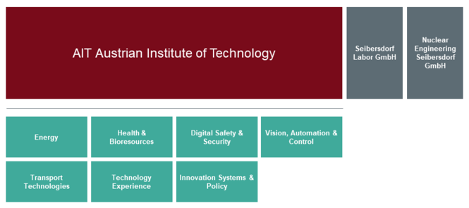
AI @ AIT
Centers
Center for Energy: Focus on innovative energy systems, renewable energy integration, and energy market policies.
Center for Digital Safety & Security: Develops technologies for cybersecurity, digital privacy, and secure communications.
Center for Health & Bioresources: Specializes in health technologies, bioresources, and molecular diagnostics.
Center for Vision, Automation & Control: Works on automation, robotics, and advanced control systems.
Center for Technology Experience: Enhances user experience through technology interaction research.
Center for Mobility Systems: Focuses on sustainable transportation, traffic safety, and intelligent mobility solutions.
Center for Innovation Systems & Policy: Provides strategic insights for innovation policies and system transformations.

Slide 7
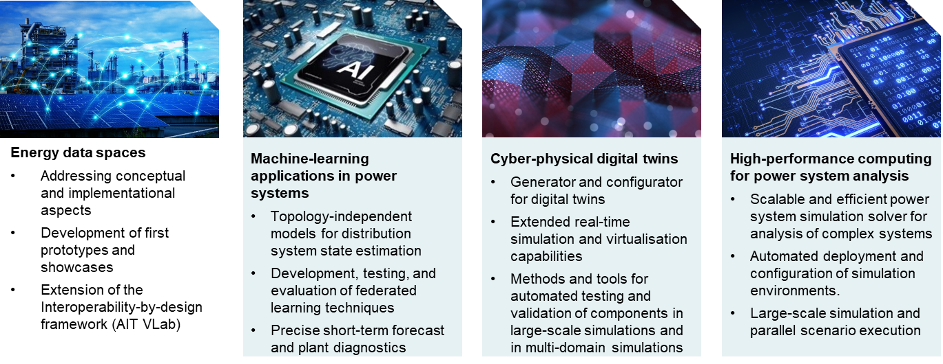
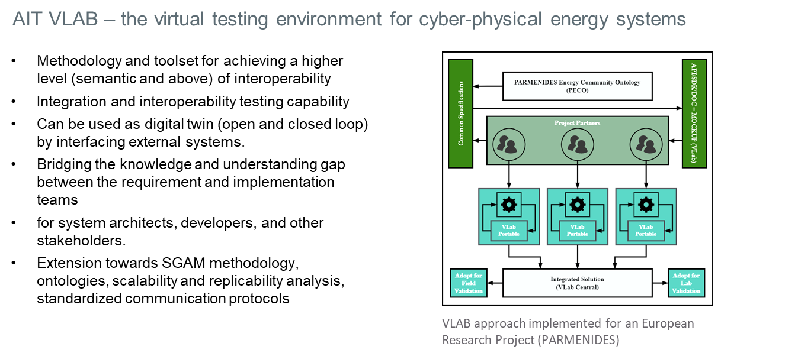
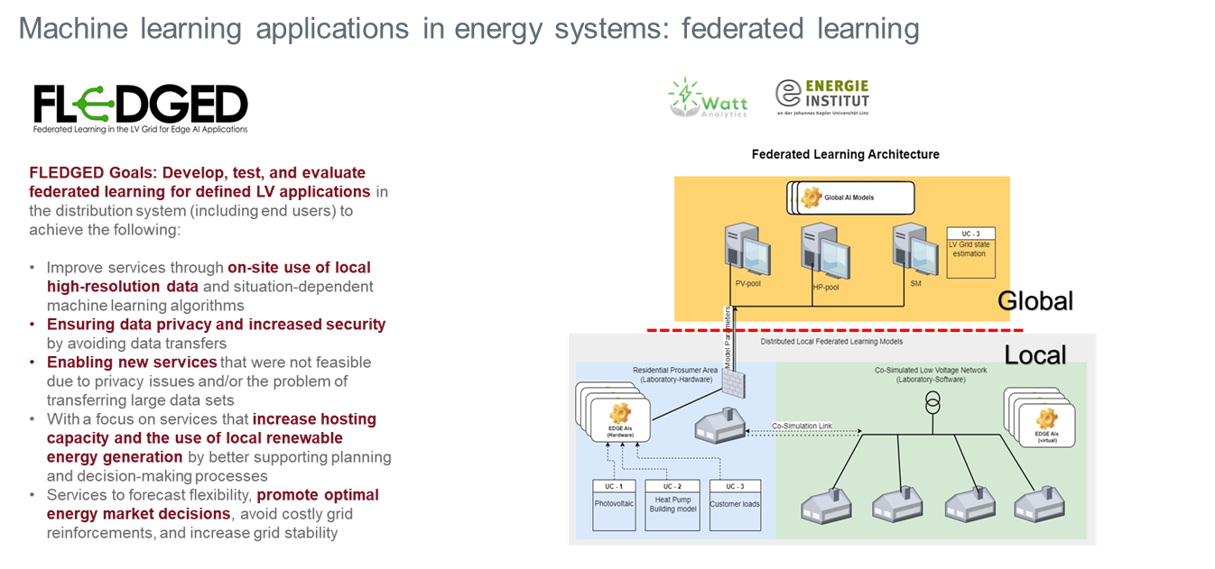

AI @ AIT
Center for Energy
AI Research Topics:
Machine-Learning in Power Systems:
  Federated learning for distribution system state estimation.
  Short-term forecasting and diagnostics.
Cyber-Physical Digital Twins:
  Real-time simulation and virtualization.
  Advanced testing and validation in large-scale simulations.
High-Performance Computing:
  Scalable and efficient AI-based power system simulation.
  Automated deployment and configuration.
Contact:
  Wolfgang.Hribernik@ait.ac.at

Slide 8
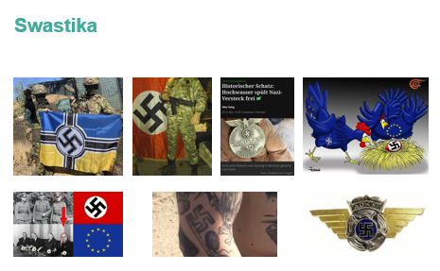
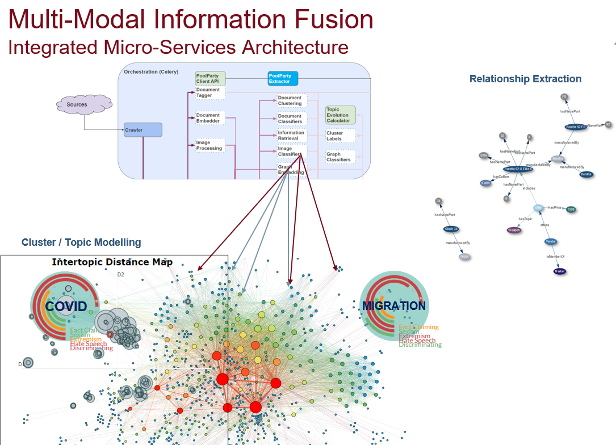
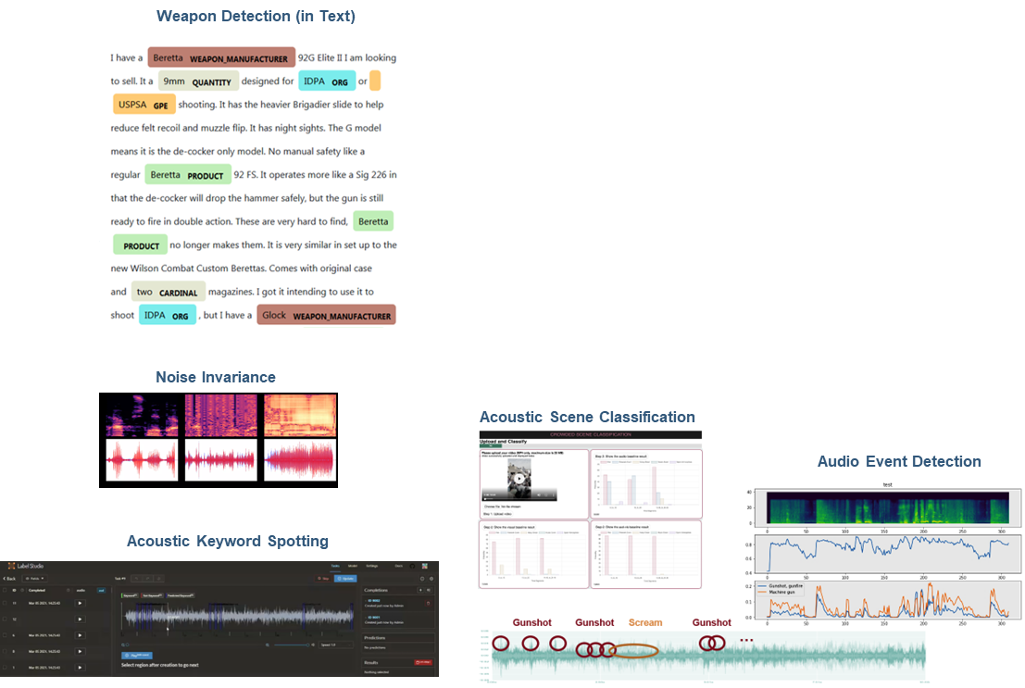
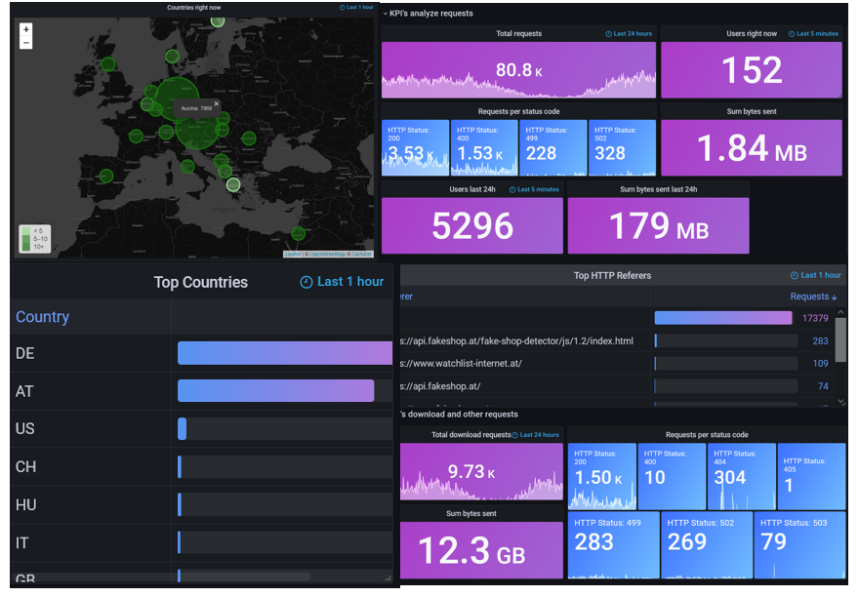
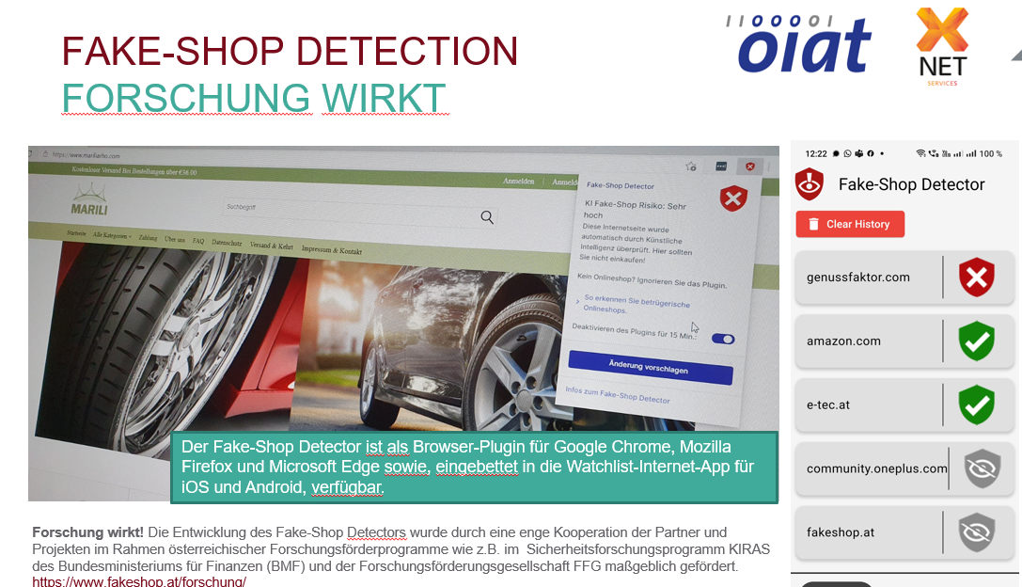
AI @ AIT
Center for Digital Safety & Security
AI Research Topics:
NLP: Desinformation, public security
Audio Analytics: detecting events, generated contet, manipulations
Computer Vision: analyzing generated content, manipulations, object detection/tracking
Neuro-symbolic AI: information modelling, fusion of multi ML-model results
Geo-spatial Analytics: marine traffic, crowd flows
Contact:
  Helmut.Leopold@ait.ac.at

Slide 9
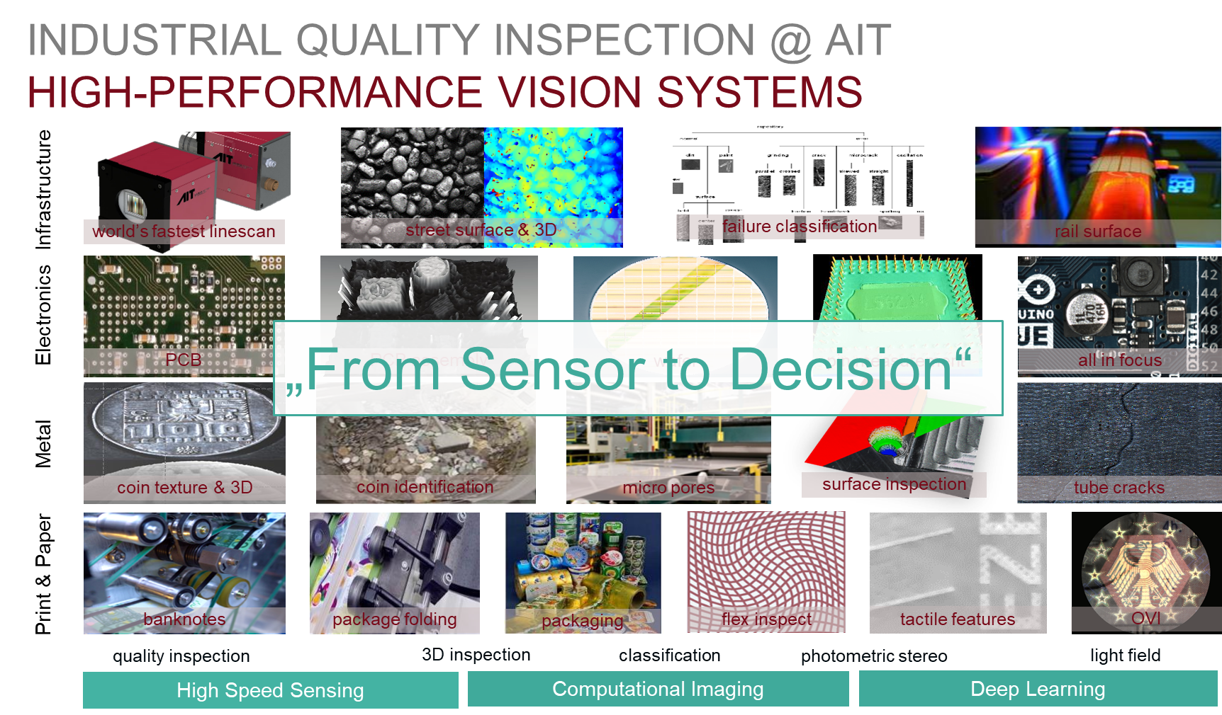
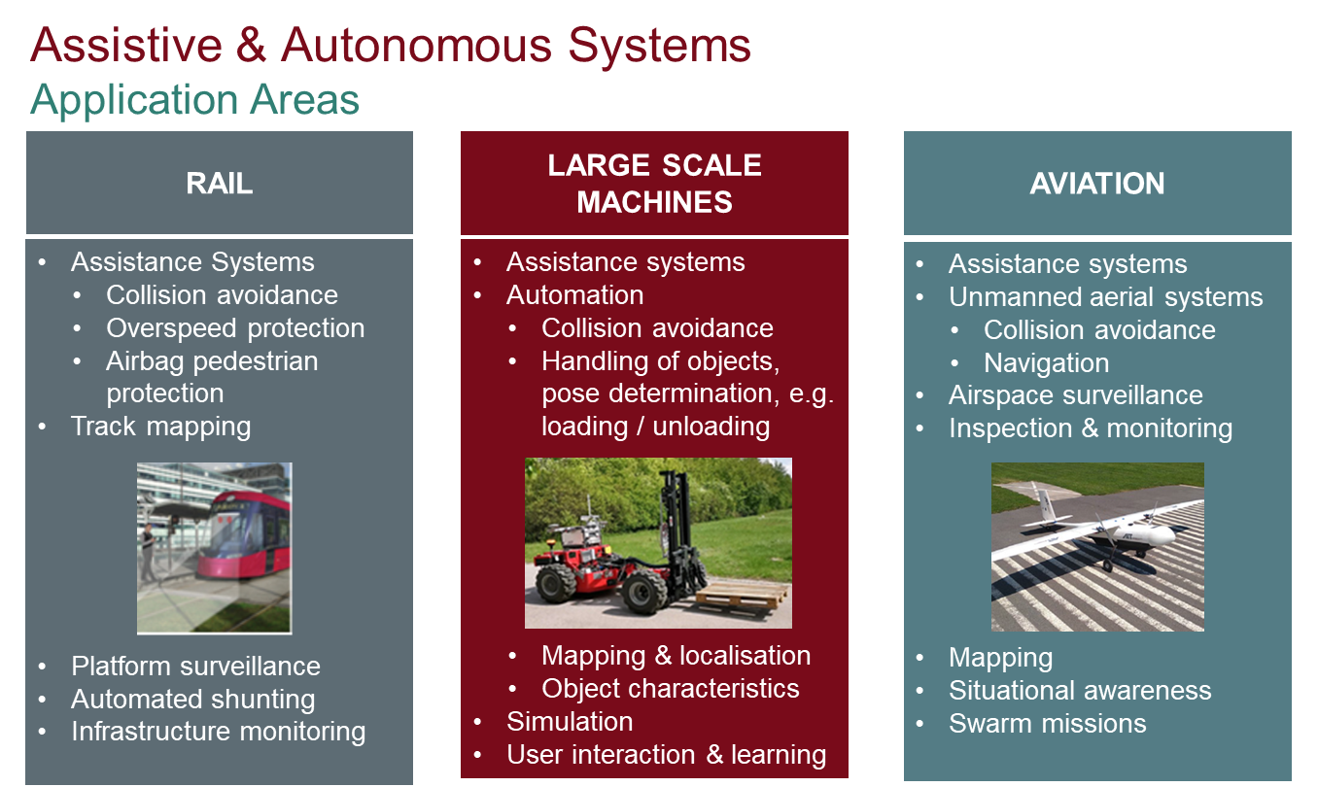
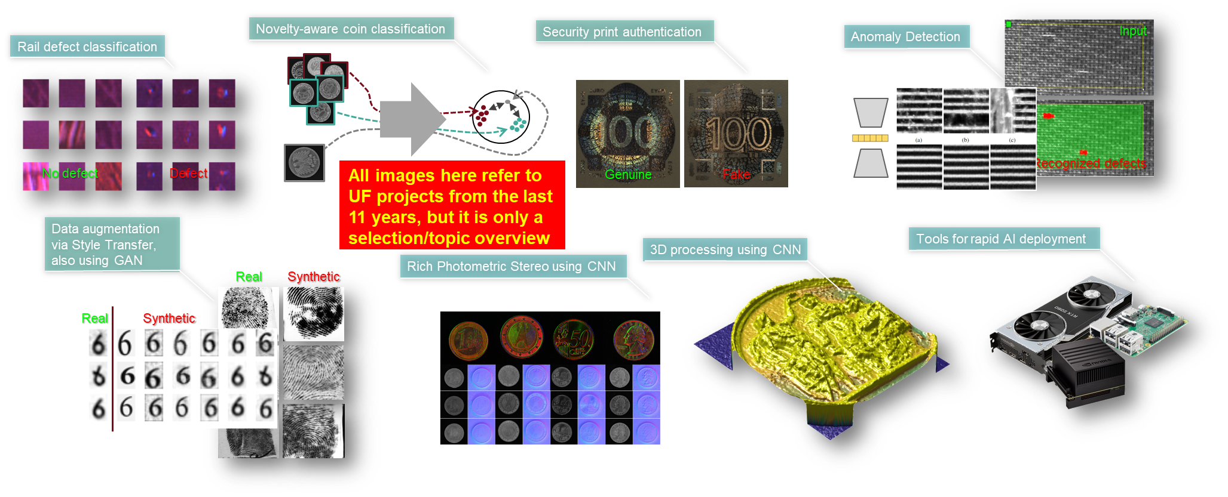
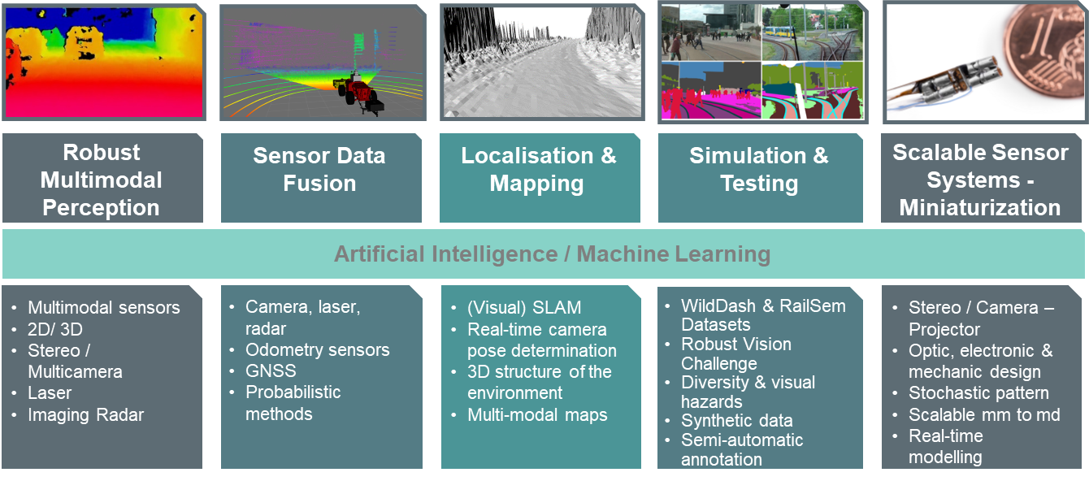
AI @ AIT
Center for Vision, Automation & Control
AI Research Topics:
Computer Vision:
  High Performance Vision Systems
  Surface quality inspection, security print authentication, Anomaly detection
  Rich Photometric Stereo
Autonomous Systems:
  Robust multimodal perception
  Sensor data Fusion
  Localisation & Mapping
  Scalable Senso System - Miniturization
Contact:
  Andreas.Vrabl@ait.ac.at

Slide 10
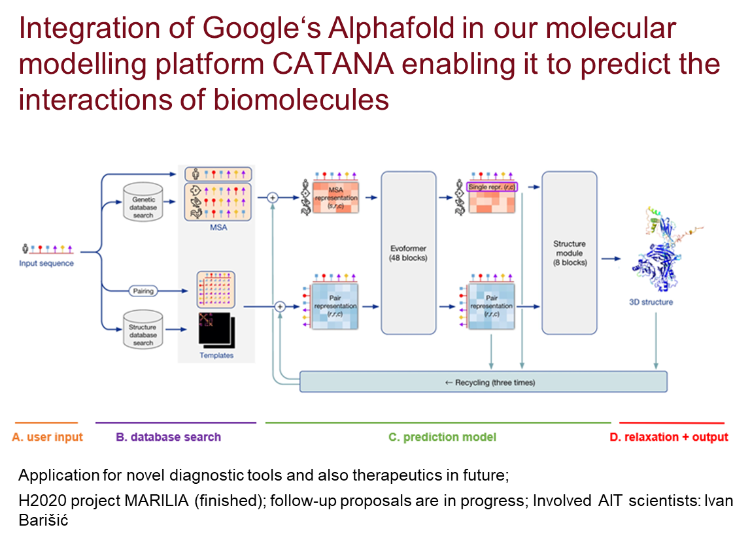
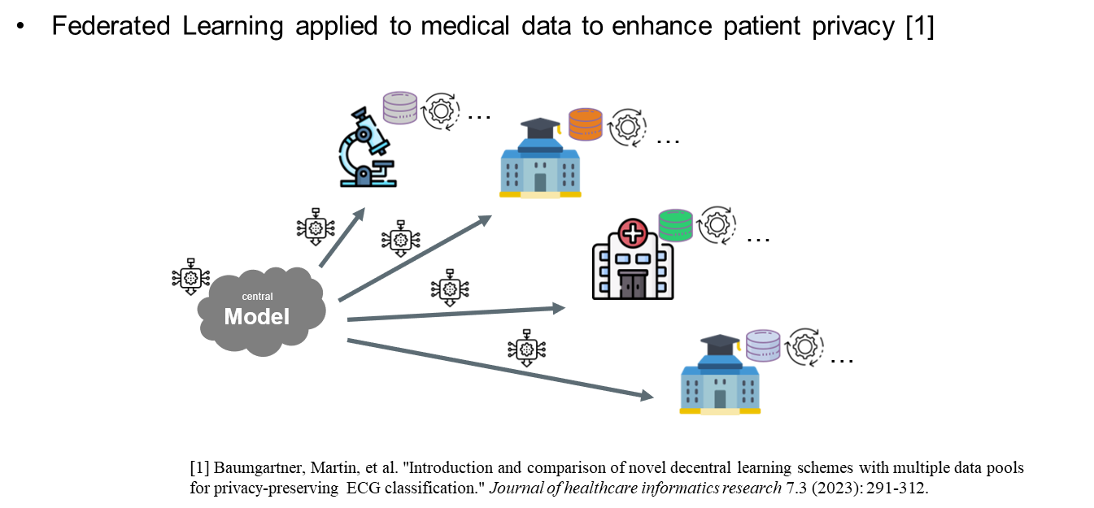
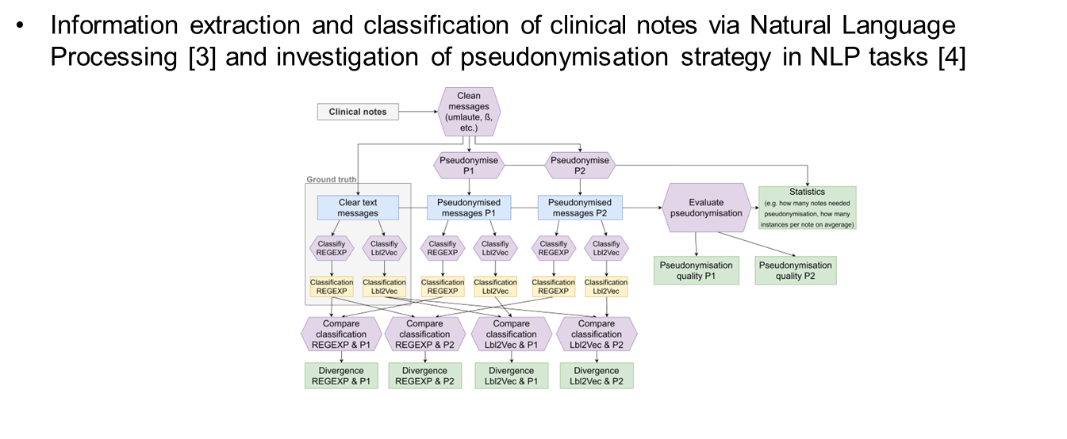
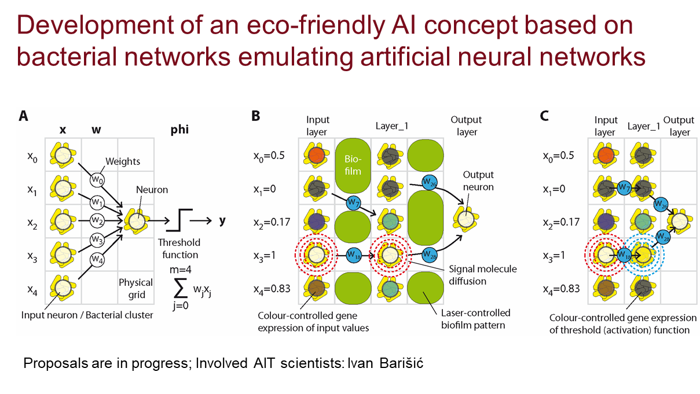
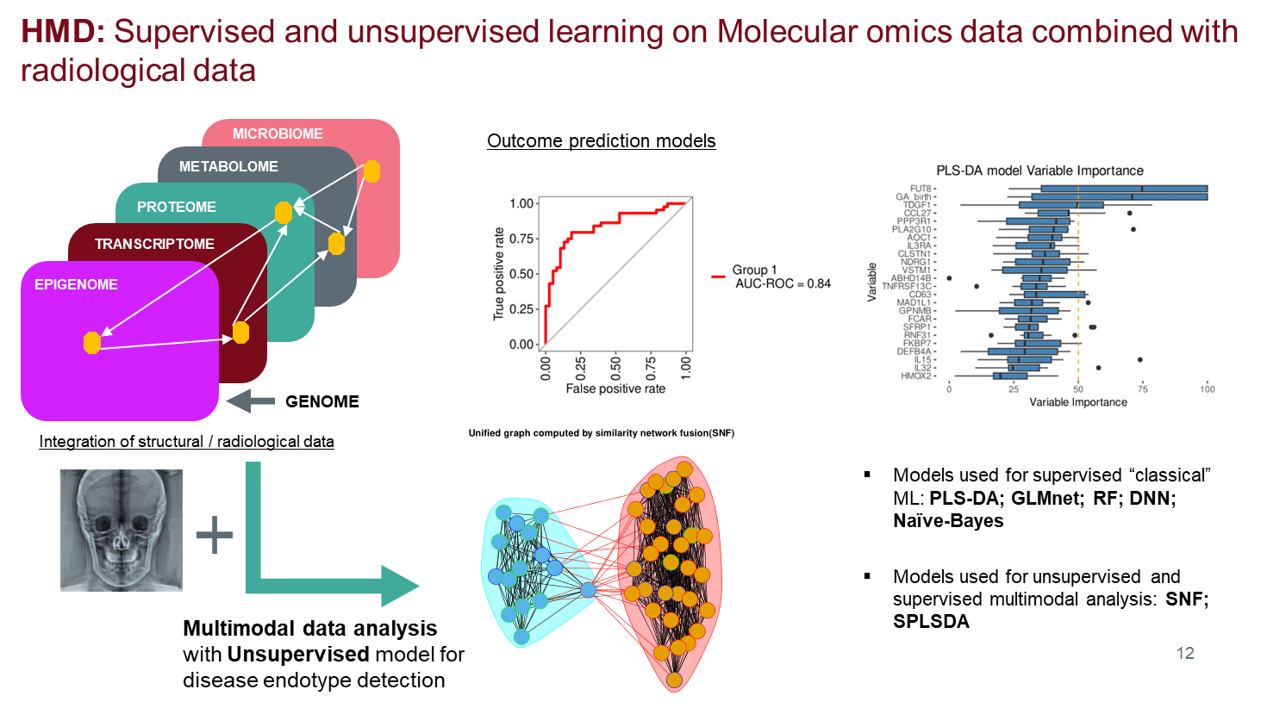
AI @ AIT
Center for Health & Bioresources
AI Research Topics:
Novel Diagnostic Tools:
  Molecular modelling platforms
  Bacterial networks emulations
Machine Learning / Deep Learning
  Predictive modelling
  Classification problems
  Federated Learning
Natural Language Processing
  Information Extraction
  Large Language Models
Contact:
  Elke.Guenther@ait.ac.at

Slide 11
AI @ AIT
Center for Technology Experience
AI Research Topics:
Contact:
  Manfred.Tscheligi@ait.ac.at

Slide 12
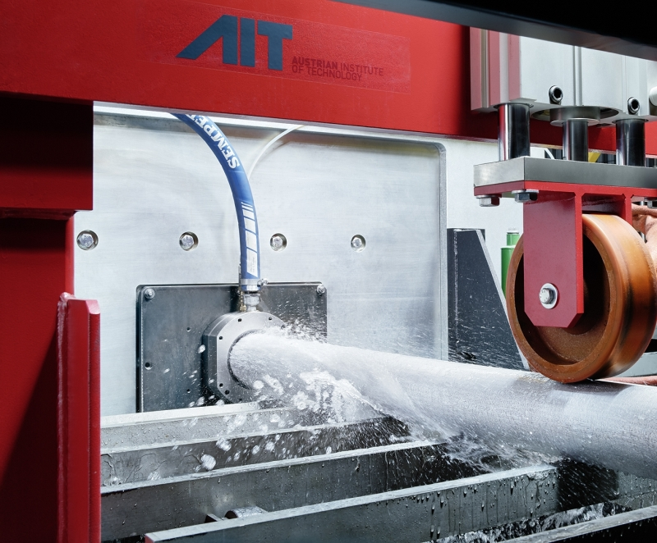
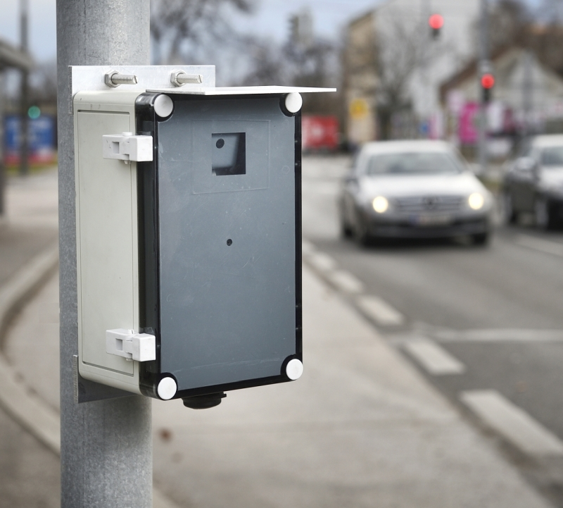
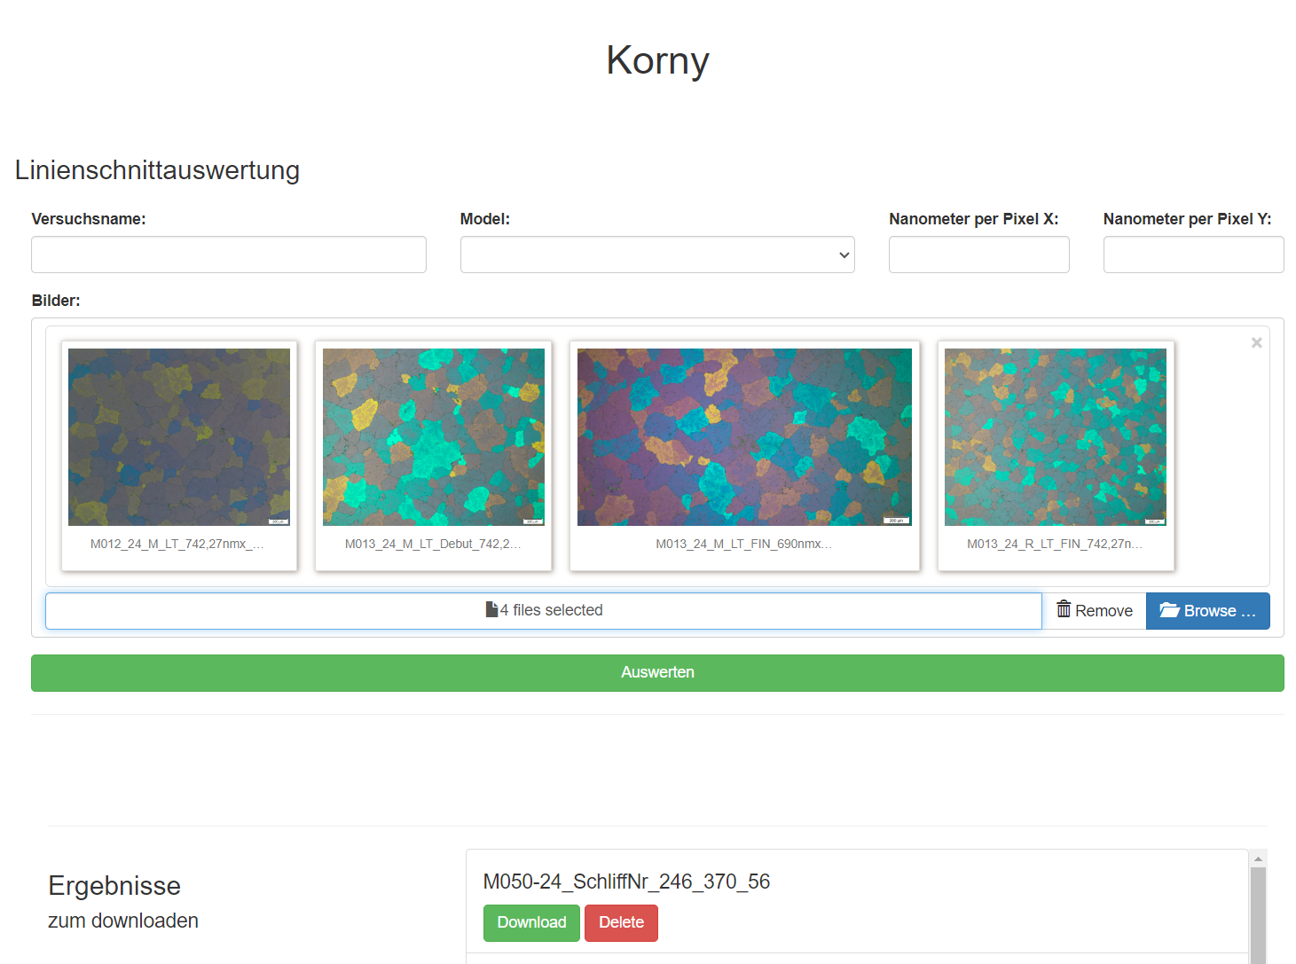
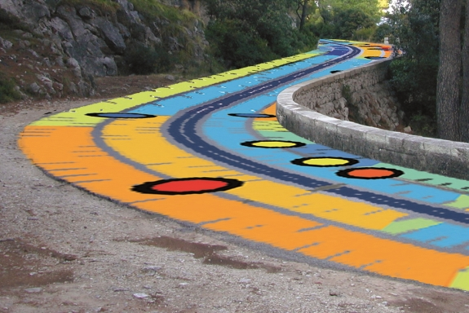
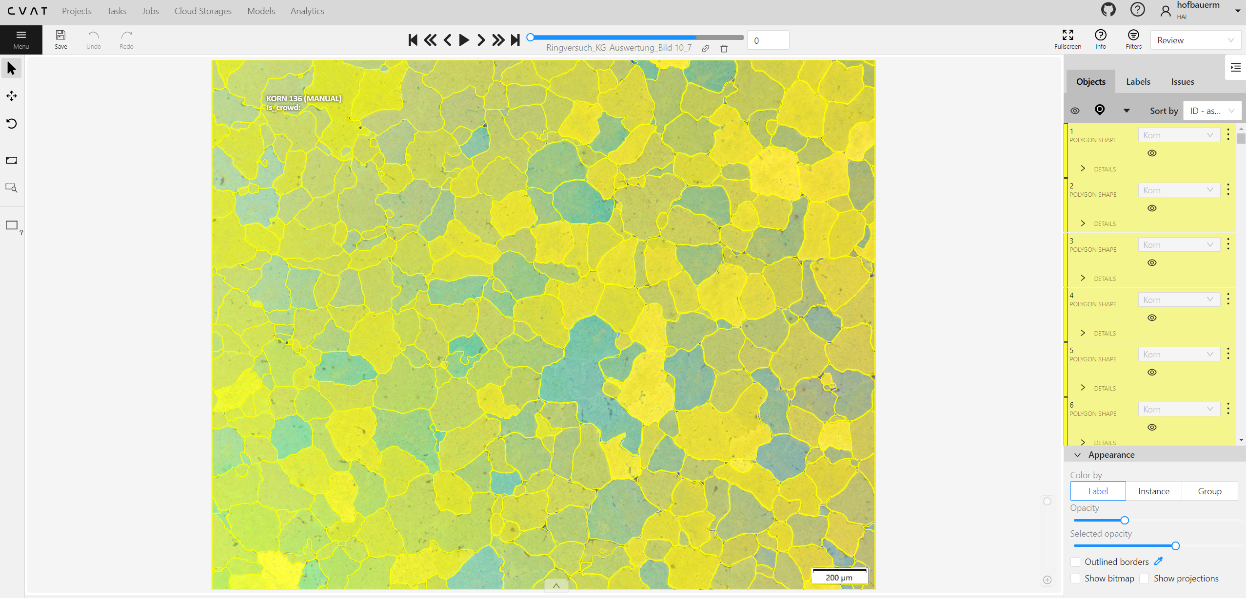
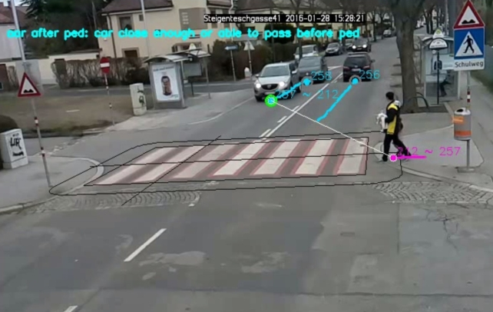
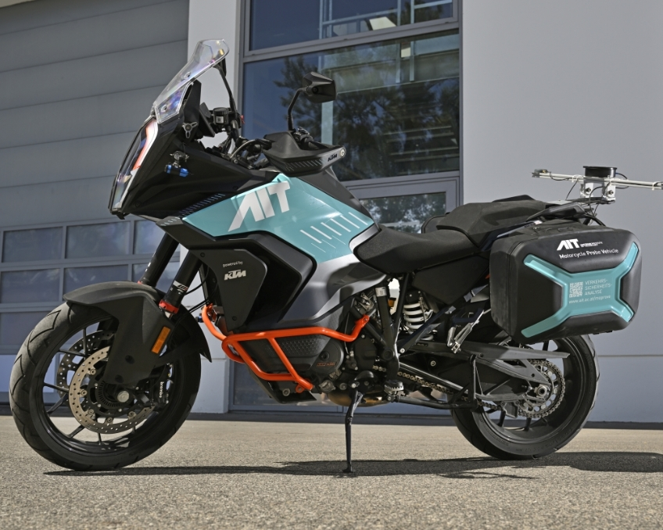
AI @ AIT
Center for Transport Technologies
AI Research Topics:
Digital assistance systems in continuous casting:
  numerical simulation tools
  digital twins of physical systems
Road Safety and Accident Research
  risk assessment, accident prediction, and road safety simulation
  analysis and simulation tools
  camera systems, mobile laboratories equipped with advanced sensor technology
Material quality inspection
  MgSi and AlFeSi segmentation of the phases in micrographs. Segmentation of dispersoids.
  Grain size measurement of micrographs
Contact:
  Christian.Chimani@ait.ac.at

Slide 13

AI @ AIT
Center for Innovation Systems & Policy
AI Research Topics:
AIT AI Ethics Lab:
  Ethics by Design
  AI Ethics consulting and policy work
AI & Research and Innovation Policy Evaluation
  AI in research and evaluation processes of R&I policies
Agent Based Modelling simulation
AI-related tools for Horizon Scanning
  detecting online criminality, topic mining, etc.
Contact:
  Matthias.Weber@ait.ac.at

Slide 14
Thank you!
Alexander Schindler

