Slide 1
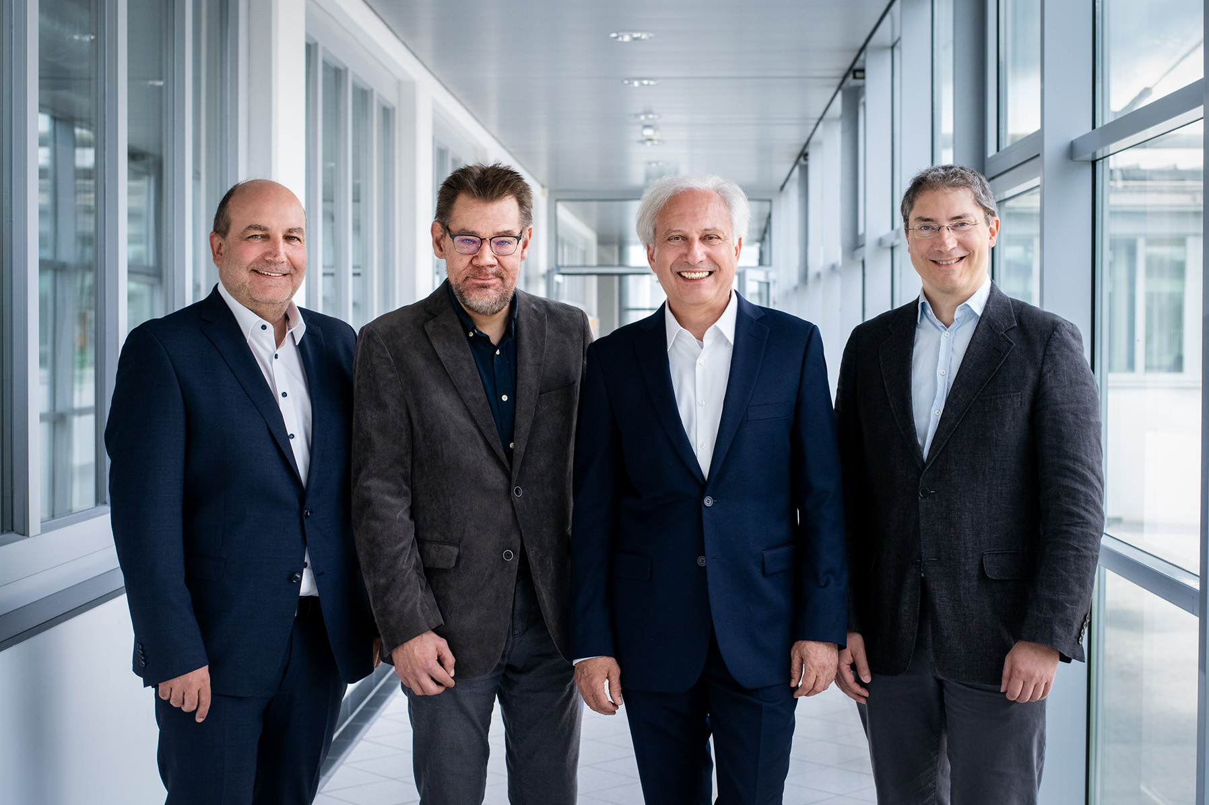
Department of
Artificial Intelligence and Cybersecurity
Highlight Topics
Recommender Systems
AI in Industrial and Social Contexts
Declarative Languages and Systems
Model-based Diagnosis and Configuration
Heuristic Problem Solving
Planning and Scheduling
Wolfgang Faber
Gerhard Friedrich
Martin Gebser
Dietmar Jannach
Group Leaders

