Slide 1
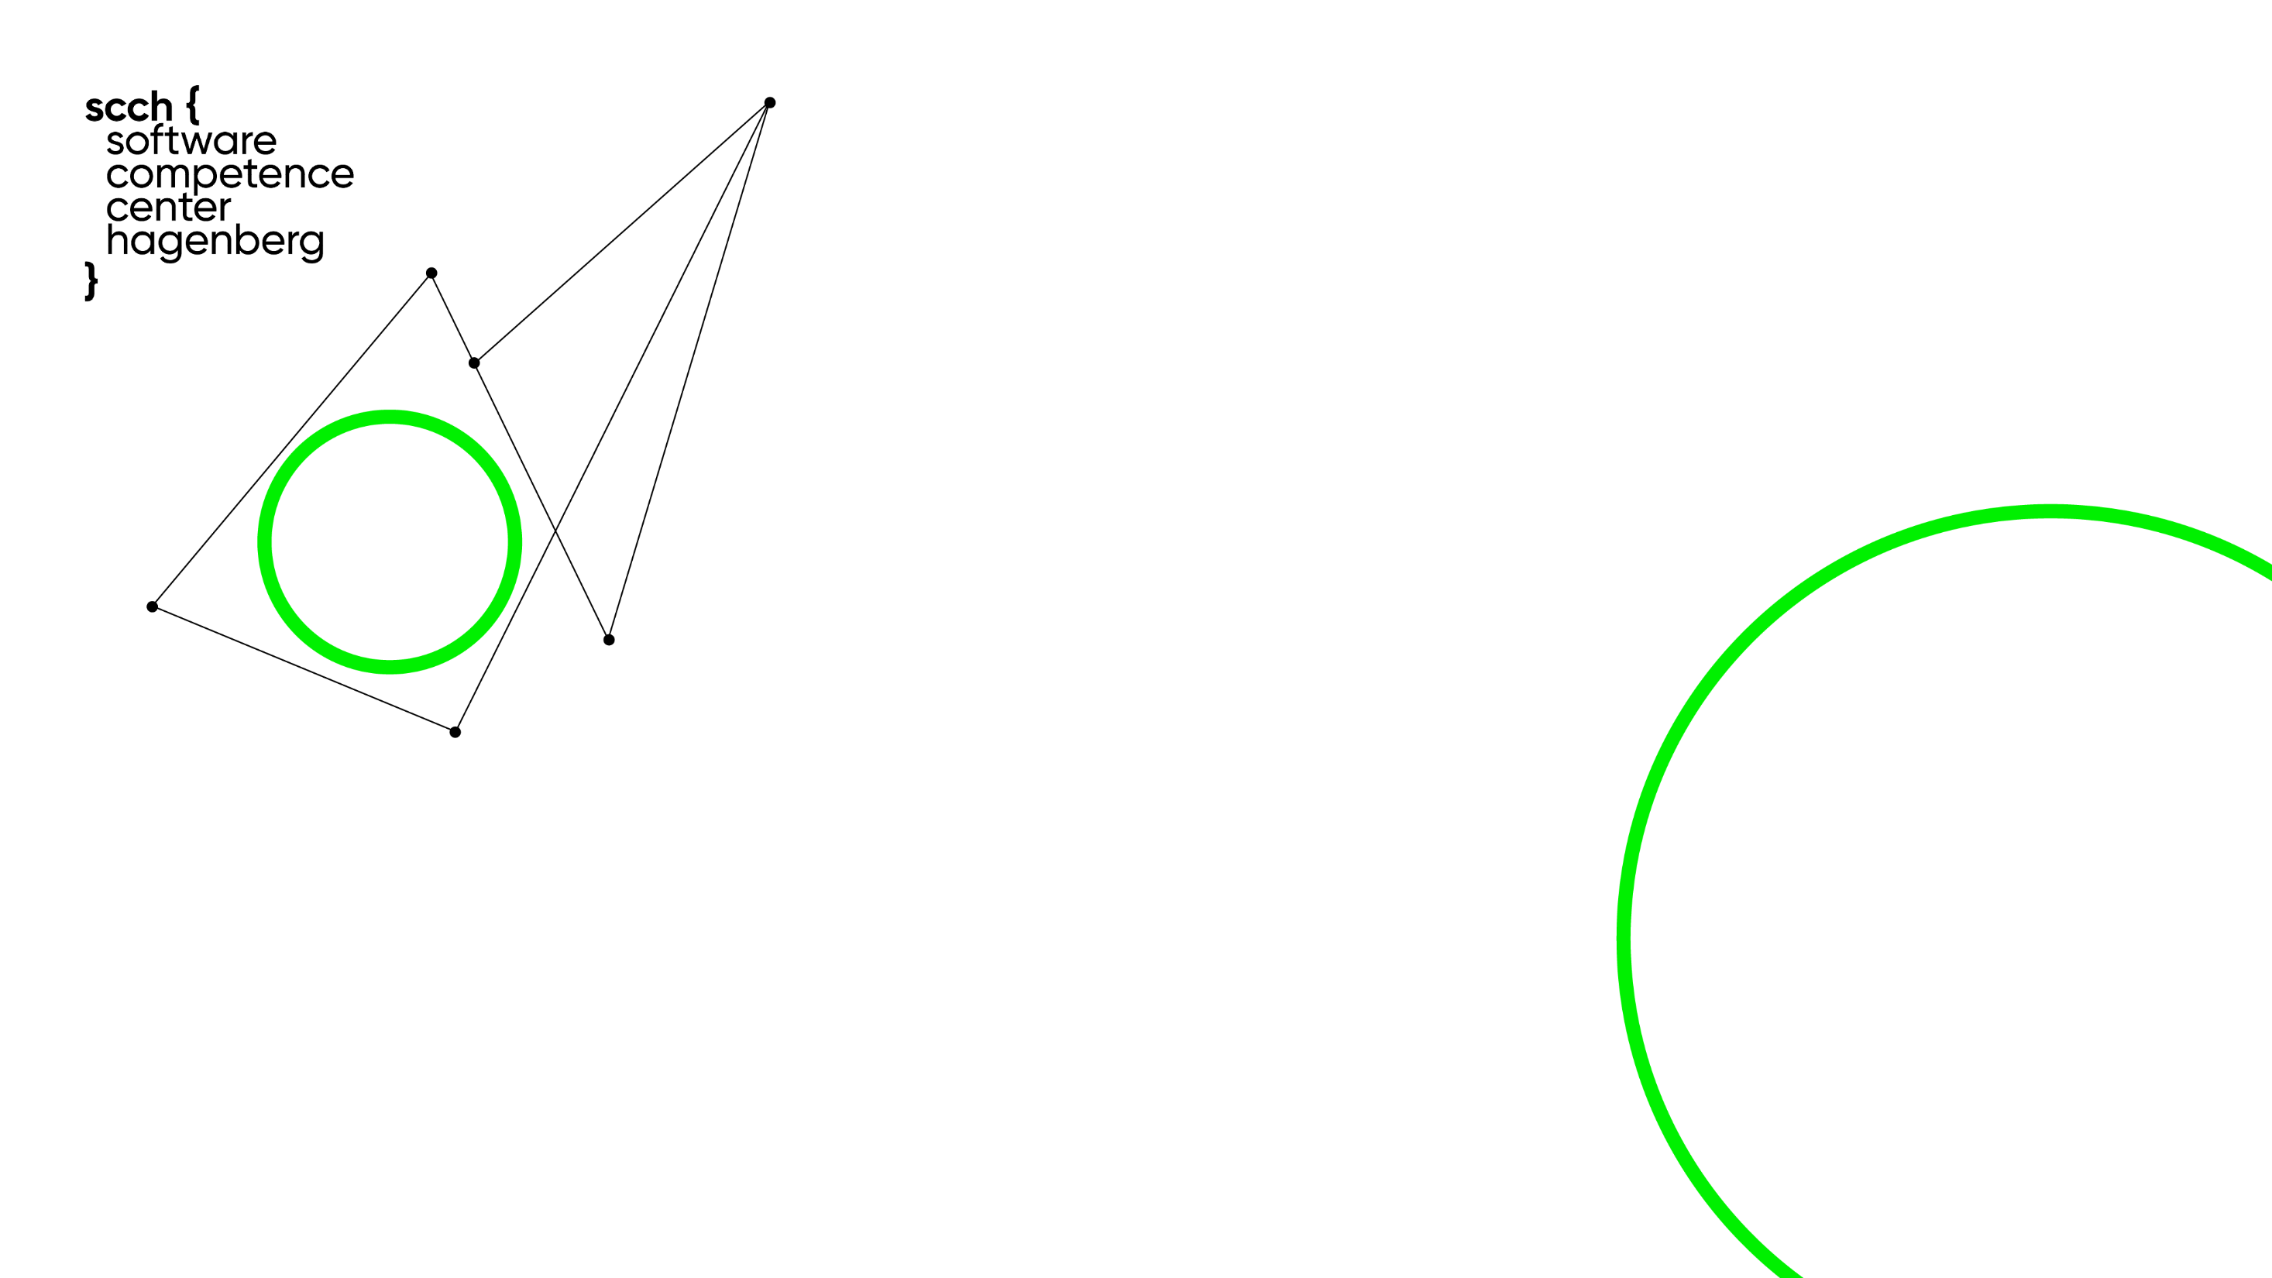





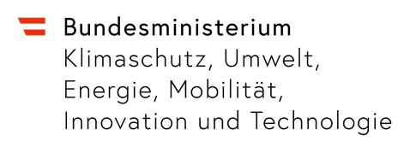
INTEGRATE
Competence Center
for Integrated Software and AI Systems
SCCH is an initiative of
  www.scch.at

Slide 3






Area 0: Emerging Technologies
Quantum Computing
characterize promising use cases for existing and future quantum processing units
develop algorithmic solutions for promising use cases using hybrid quantum-classical algorithms
Contact: Prof. Dr. Robert Wille
Neuromorphic Computing
Spiking-based sampling and learning as a key technology for highly efficient AI on edge devices
well-suited for medical imaging and early diagnosis in healthcare
Contact: Priv.-Doz. Dr. Bernhard Moser
expECT
Experimenting with Emerging Computing Technologies
strECT
Strategic Research on Emerging Computing Technologies
3

Slide 4




















Area 1: Data and AI Modeling
Advanced Learning Techniques: Transfer Learning, Domain Adaptation, Hybrid Models (NLP + Vision Transformers)
Data Integration: Heterogeneous Data Fusion, Data Catalogs & Quality
Causal & Predictive Models: Causal Inference, Digital Twins, Anomaly Detection & Prediction
Optimization & Reinforcement: Federated Transfer Learning, Hierarchical & Distributed RL
Human-AI Interaction: Explainability, Human-Agent Collaboration, AI Perception & Orchestration, AI Engineering
AIPRA
AI-Assisted Prescriptive Analytics
SPOC
Sustainable Process Cognition
DANTE
Data Centric AI Engineering
SUSTAIN
Scalable Optimization and Control
Area 1
CVRL
Computer Vision and Representation Learning
TFI
Transferable Intelligence
4

Slide 5







Area 2: Software Systems Engineering
COMPASS
Complex Software Systems Analysis
Comprehensive Systems & Software Analysis: Holistic analysis, AI-based software analysis, formal and semantic models.
Code & Development: Learning from code, no-code/low-code adoption, user interface design, end-user software engineering.
Automation & Innovation: Automating engineering, new technologies in software engineering.
Sustainability: Supporting sustainable systems.
AISYS
AI-based Engineering of Sustainable Systems
HUMACE
Human-Centered System Design
Area 2
SEA
Software Engineering Approaches for Evolving Systems
5

Slide 6
Area 3: Integrated Monitoring and Diagnosis
AISEC
AI Regulations
& Security
Industry Adaptation & Protection: DEPS protection, software obfuscation, reusable protection framework.
Secure & Private Learning: Federated Learning with Homomorphic Encryption, Differentially Private ML
Privacy & Trust: Privacy-leakage evaluation, trustworthy AI
System Observations & Testing: Runtime observations, post-release testing, self-verification.
Debugging & QA Improvement: Debugging support, system behaviour recording, utilizing operational data for QA
MONTE
Runtime Monitoring and Self-Testing
PROTECT
Protection of IP in Industry Software and AI
Area 3
INTES
Integrated Tool Ecosystem for Ensuring Standards and
Regulations
6

Slide 7

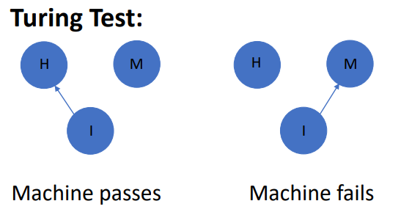





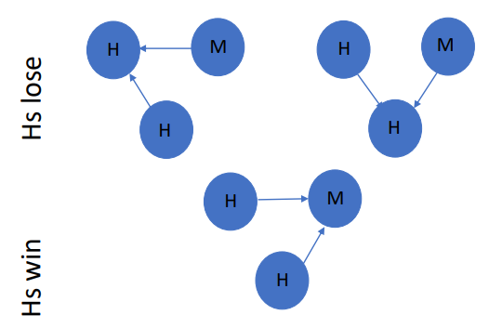





Intelligent Systems and Certification of AI
Group Lead: DI Dr. Bernhard Nessler
Interdisciplinary Research Group for AI and Law
Simon Schmid, ML Researcher
Patrick Mederitsch, ML Researcher
Michal Lewandowski, ML Researcher
Gregor Aichinger, Legal Researcher
Alexander Aufreiter, Legal Researcher
Research and development: Focus on new test methods and certifiable machine learning models.
Standardization: Contribution to the new industry standards.
Regulatory influence: Participation in European legal regulations (AI Act).
The Turing Game
will be presented at the
Ars Electronica Festival
4th-8th September
Turing Game:

Slide 8




SCCH’s Spin-Offs
Sysparency
automates the documentation and analysis of SAP® system, transforming them into understandable, human-readable formats
The result is used to automatically create an online-compatible WIKI
www.sysparency.com
Contact Person: Mag. Michael Moser
TrustifAI
ensure AI applications are trustworthy, safe, and reliable
offers a certification for the trustworthiness of AI used in businesses
www.trustifai.at
Contact person: DI Dr. Bernhard Nessler
Upcoming - BirthAI
increase pregnancy success rates in IVF by data-driven decisions during the process
analyze embryonic images and clinical data to identify the best embryos for implantation
Contact person: Dr. Florian Kromp

Slide 9
















Ongoing Projects
12 COMET Projects with 23 company partners
2 COMET Modules
19 international funding Projects (H2020, Horizon, Interreg)
30 national funding Projects (FFG, WWTF, FWF)
Additionally, several direct contract research projects

Slide 10
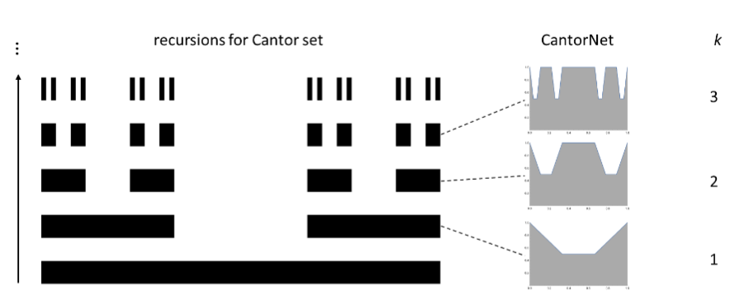
CantorNet
Inspired by the construction of the Cantor set.
  Two ReLU nets with O(k) and O(2^k) neurons.
  Same decision boundary.
Sandbox for studying topological and geometrical complexity measures
We measure local deviations from convexity in the activation space
On Space Folds of ReLU Networks. ICLR 2025?

Slide 11
https://www.scch.at/scch/team
Robert Wille
CSO
robert.wille@scch.at
Markus Manz
CEO
markus.manz@scch.at

Slide 12
Lukas Fischer
Research Manager Data Science
lukas.fischer@scch.at
Volkmar Wieser
Area Manager Data Science
volkmar.wieser@scch.at
Robert Wille
CSO
robert.wille@scch.at
Markus Manz
CEO
markus.manz@scch.at

