Slide 1

NLP Lab
Digitale Textwissenschaften
@University of Vienna
Faculty of Philological and Cultural Studies
Faculty of Computer Science
Benjamin Roth, Anastasiia Sedova, Andreas Stephan, Vasiliki Kougia, Pedro Luz de Araujo, Xia Yuxi, Lukas Thomas, Lena Zellinger, Loris Schönegger, Leonardo Bergmann

Slide 2
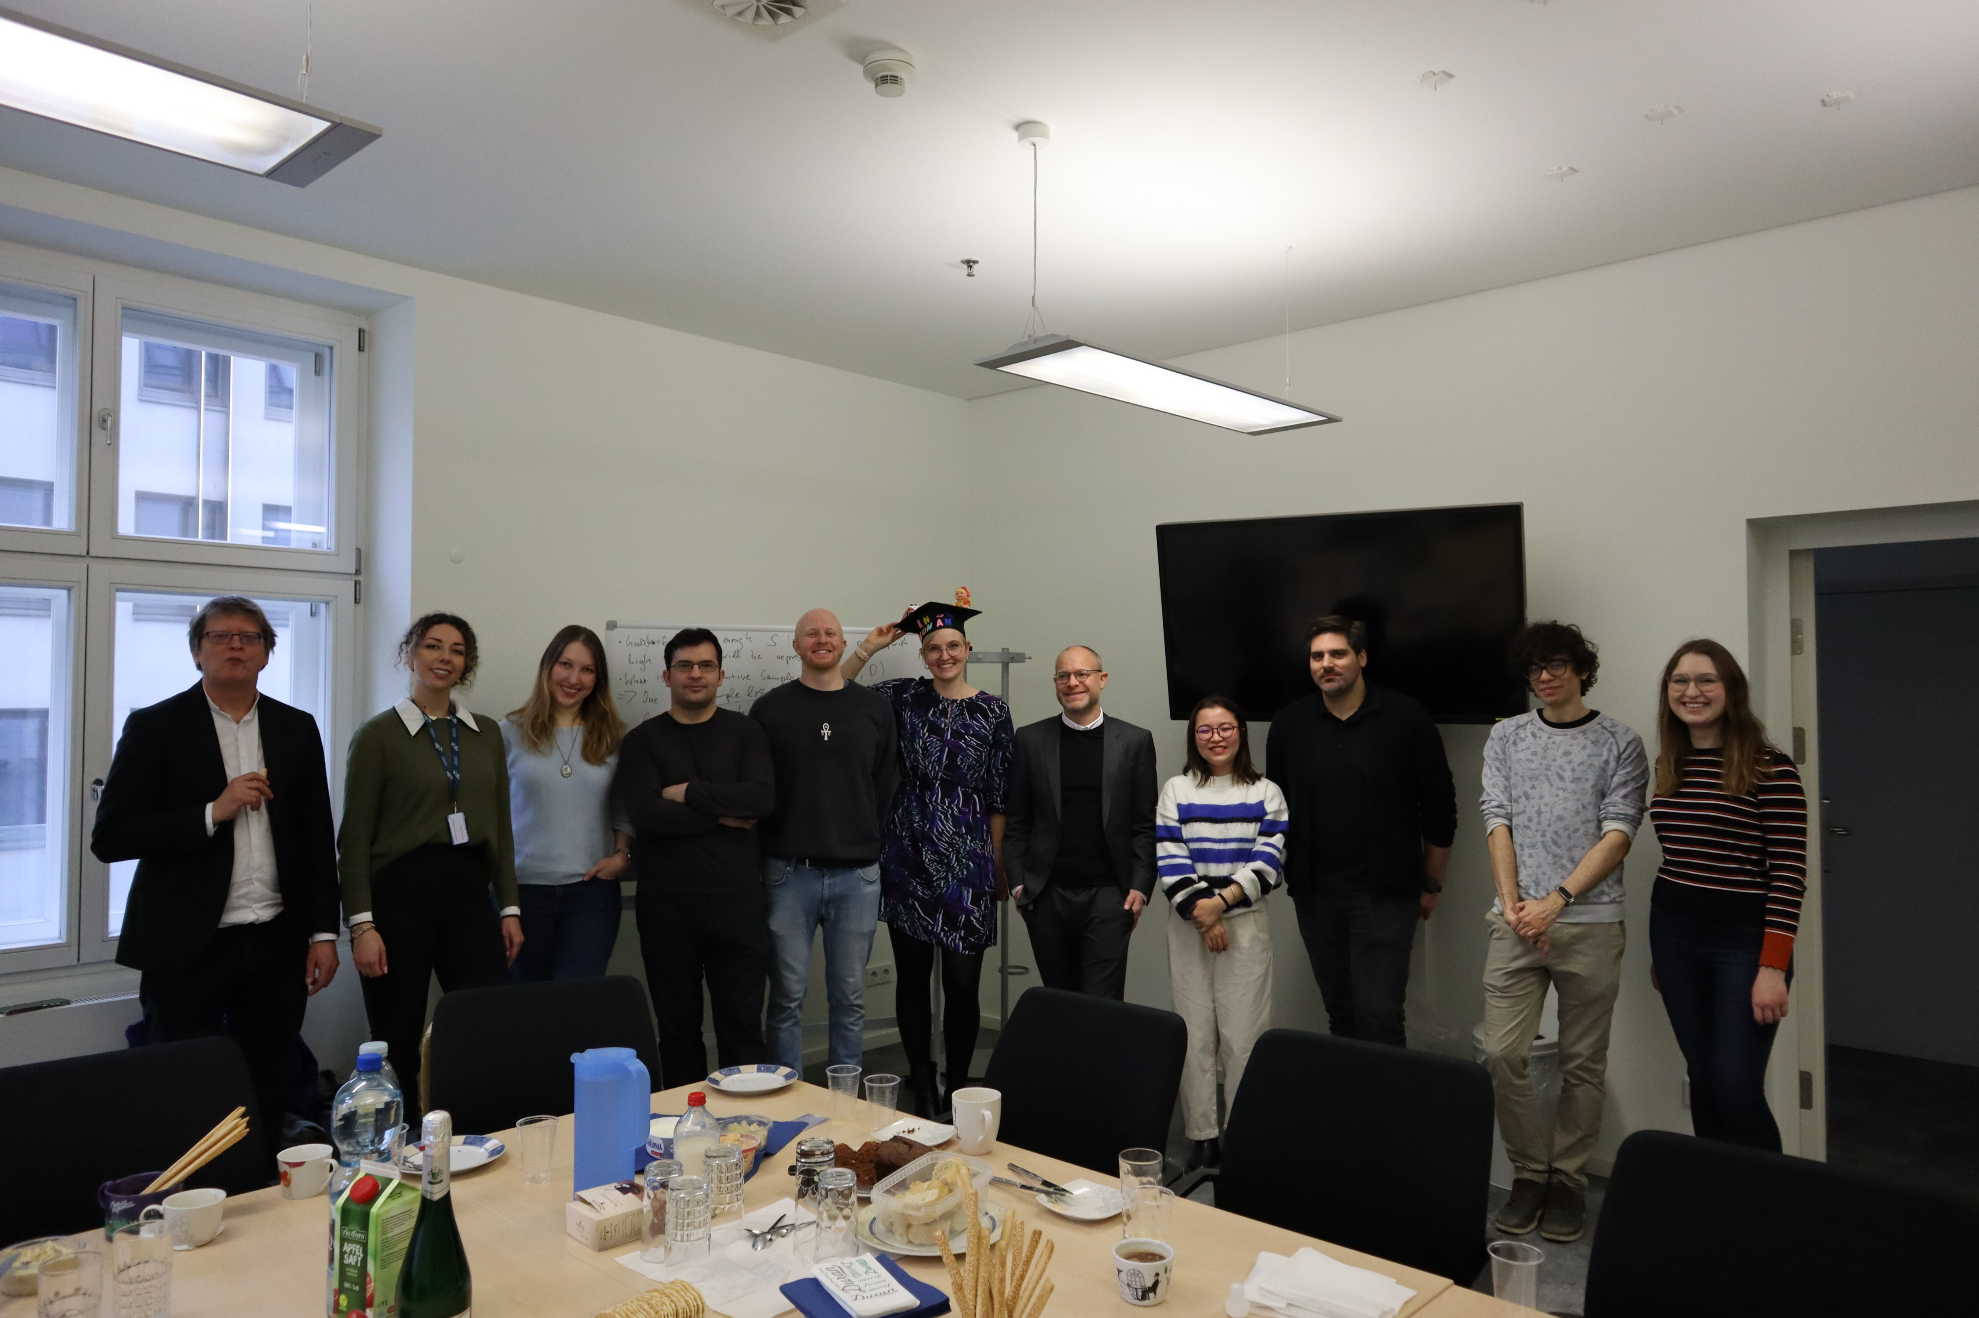

Slide 3




Funded Projects: Machine Learning & Computational Linguistics
Knowledge-infused Deep Learning for Natural Language Processing
  PI: Benjamin Roth
  WWTF Vienna Research Group
Cognitive Plausibility of Deep Learning Language Models (CogML)
  PI: Lukas Thoma, Ivonne Weyers
  ÖAW go!digital 3.0
Representing Sets in Embeddings of Relational Information
  PI: Benjamin Roth
  DFG
The Universal Dependency scheme and the test Treebank of Georgian
  PI: Irina Lobzhanidze, Host: Benjamin Roth
  ÖAW Joint Excellence in Science and Humanities
Detection of Euphemistic Abuse
  PI: Michael Wiegand
  FWF

Slide 4
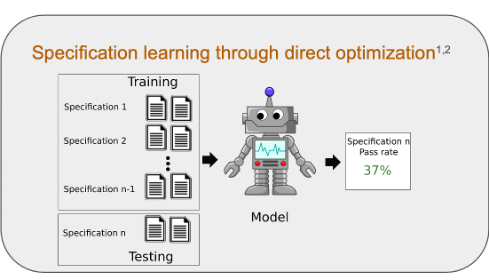
Specification learning and multi-metric analysis
Publications and preprints:
1. Checking HateCheck: a cross-functional analysis of behaviour-aware learning for hate speech detection [Luz de Araujo & Roth, NLP Power @ ACL 2022]
2. Cross-functional Analysis of Generalization in Behavioral Learning [Luz de Araujo & Roth, TACL 2023]
3. Functionality learning through specification instructions [Luz de Araujo & Roth, preprint available at https://arxiv.org/abs/2311.08481]
4. Specification Overfitting in Artificial Intelligence [Roth et al., preprint available at https://arxiv.org/abs/2403.08425]

Slide 5
Text-Guided Image Clustering
Andreas Stephan, Lukas Miklautz, Kevin Sidak, Jan Philip Wahle,
Bela Gipp, Claudia Plant and Benjamin Roth, EACL 2024
Use image-to-text models to generate textual descriptions of images, subsequently cluster only text.
Prompting can guide the clustering to focus on certain aspects
We observe:
Text-based image clustering often outperforms image-based clustering
Generated text makes cluster better interpretable

Slide 6
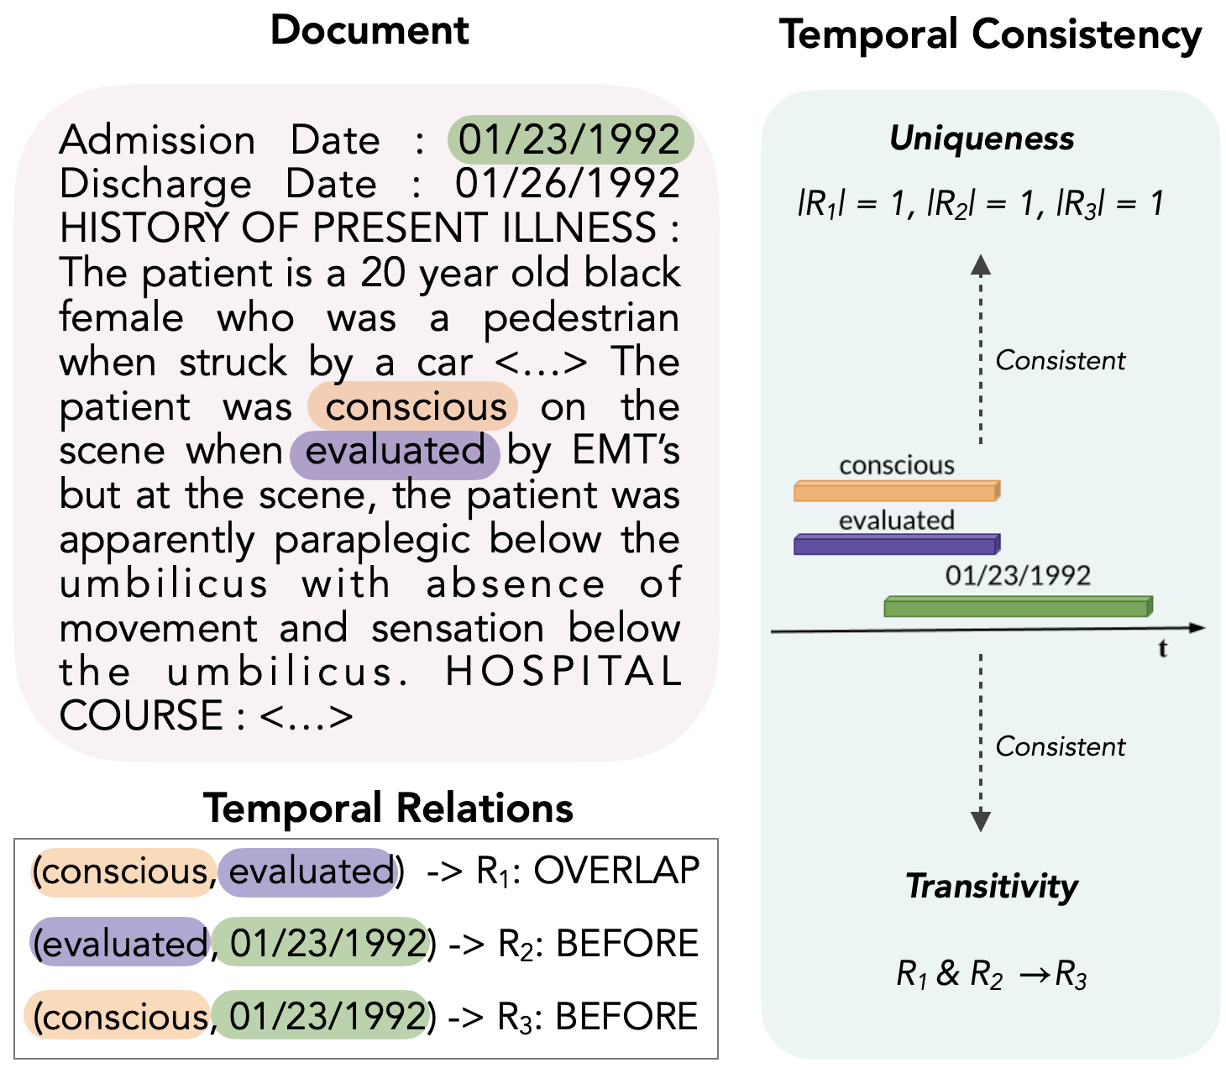
Temporal Relation Extraction with LLMs and Temporal Reasoning
Analysing zero-shot temporal relation extraction on clinical notes using temporal consistency
Kougia, V., Sedova, A., Stephan, A., Zaporojets, K., & Roth, B.
In the 23rd BioNLP Workshop and Shared Tasks @ ACL 2024

Slide 7
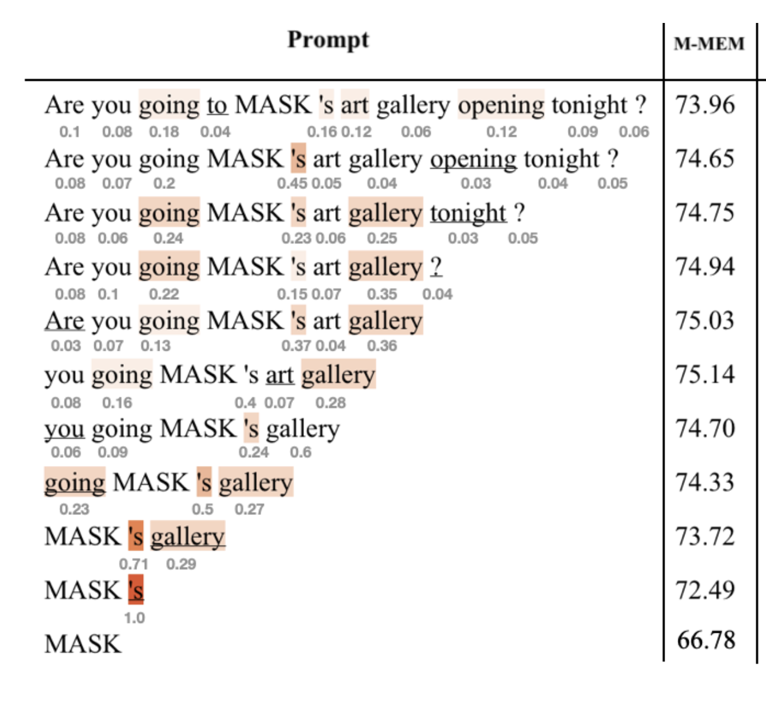
Memorization in Language Models
Exploring prompts to elicit memorization in masked language model-based named entity recognition
Yuxi Xia, Anastasiia Sedova, Pedro Henrique Luz de Araujo, Vasiliki Kougia, Lisa Nußbaumer, Benjamin Roth
Link: https://arxiv.org/pdf/2405.03004

Slide 8

Euphemistic Abuse –
A New Dataset and Classification Experiments for
Implicitly Abusive Language
Michael Wiegand, Jana Kampfmeier, Elisabeth Eder, Josef Ruppenhofer
(EMNLP, 2023)
Cue Phrases
You are boring.
You are stupid.
You are arrogant.
Generation of Euphemistic Abuse
Filtering
Validation
Task
Gold Standard
Euphemistic Abuse
You inspire me to fall asleep.
Intelligence has never been your thing.
You should compete in the ego olympics.
Other Sentences
You inspire me to get another job.
Strict punctuality has never been your thing.
You should compete in the Olympics.
Fragment Extraction
Consistency Task
Fragments
You inspire me to …
… has never been your thing.
You should compete in …
Generation of Other Sentences
Filtering
Validation Task

Slide 9
Sedova et al. 2024. To Know or Not To Know? Analyzing Self-Consistency of Large Language Models under Ambiguity. ACL 2024 (under review) https://openreview.net/attachment?id=ahh5eXkKKc&name=pdf
            Behavioral Testing of how well and how consistently LLMs can apply the knowledge it possesses.
Sedova and Roth. ULF: Unsupervised Labeling Function Correction using Cross-Validation for Weak Supervision. EMNLP 2023 https://arxiv.org/pdf/2204.06863
            Introduce new noise reduction techniques of weakly supervised data without using additional manual annotations.
Sedova and Roth. 2023. ACTC: Active Threshold Calibration for Cold-Start Knowledge Graph Completion. ACL 2023 https://aclanthology.org/2023.acl-short.158.pdf
            Efficient knowledge graph population with minimal annotation budget.
Sedova et al. 2023. Learning with Noisy Labels by Adaptive Gradient-Based Outlier Removal. ECML PKDD 2023 https://arxiv.org/pdf/2306.04502
            Analyze the model's ability to learn from noisy annotations: instead of denoising the training dataset, it is adjusted dynamically during the training process.
Sedova et al. 2021. Knodle: Modular Weakly Supervised Learning with PyTorch. RepL4NLP @ ACL 2021 https://aclanthology.org/2021.repl4nlp-1.12.pdf
            Benchmarking framework for weak supervision.

Slide 10
Thank you!

